Slide 1

iCrypt-101 WELCOME TO NEW DIMENSION OF ENCRYPTION Powered By JAVA 7.0
arpit srivastava : cse/1119210032
sahiba mittal : cse/1119210095
Under guidance of vikas kumar
(Ass. Professor, Cse, GLBITM)

Slide 2
CONTENTS
Abstract
Why Encryption
Algorithm and Coding
Ciphers
Caesar Cipher
Vigenere Cipher
RSA Cipher
Image Steganography
GUI
Its Applications
References

Slide 3
ABSTRACT
It is comprised of a 4 encryption patterns with Caesar cipher, Vigenere cipher, RSA cipher and Image Stagenography.
It undergoes through these different types of cryptographies practiced in real world.
Provides high security.
Also it contains a help website for proper use of information about various phases of software.

Slide 4
WHY ENCRYPTION ??
Encryption which is a process of converting ordinary information into unintelligible cipher text provides :
Confidentiality : keeps data private from unintended user.
Authenticity : provides proof of identity of sender to assure who/what he/she claims to be.
Integrity : ensures that data during its transit is not tampered with.
Non-Repudiation : ensures that information cannot be disowned.

Slide 5
Algorithm and Coding
The algorithm consists of 4 times application of encryption. The idea is first use the caesar cipher encryption of text, then again encrypt the text with vigenere and next with RSA.
After the encryption of text, it is encrypted in the form of pixel array of image which is most challenging!
Platform for coding is JAVA using IDE – Eclipse.

Slide 6
CIPHERS IN DETAIL

Slide 7
CAESAR CIPHER ENCRYPTION
It is type of substitution cipher in which each letter in the plaintext is replaced by a letter some fixed number of positions down the alphabet.
Encryption of a letter x by a shift n can be described as :
Similarly Decryption :

Slide 8
The transformation can be represented by aligning two alphabets; the cipher alphabet is the plain alphabet rotated left or right by some number of positions.
For instance, here is a Caesar cipher using a left rotation of three places (the shift parameter, here 3, is used as the key) :
Plain: ABCDEFGHIJKLMNOPQRSTUVWXYZ
Cipher: DEFGHIJKLMNOPQRSTUVWXYZABC

Slide 9
Example
When encrypting, a person looks up each letter of the message in the "plain" line and writes down the corresponding letter in the "cipher" line. Deciphering is done in reverse.

Slide 10
VIGENERE CIPHER ENCRYPTION
A polyalphabetic substitution cipher involves one-to-many relationship between each letter and its substitutes.
A table of alphabets is used called as Vigenere table.
Example : Plain Text = ATTACKATDAWN
Keyword = LEMON
= LEMONLEMONLE
Cipher Text is calculated using Vigenere Table.

Slide 11

So, Cipher Text = LXFOPVEFRNHR

Slide 12
RSA CIPHER ENCRYPTION
Algorithm for public-key cryptography, involves a public key and a private key.
Messages encrypted with the public key can only be decrypted using the private key, which only receiver can hold.
Efficiently implemented with popular “crypto” libraries (Java).

Slide 13
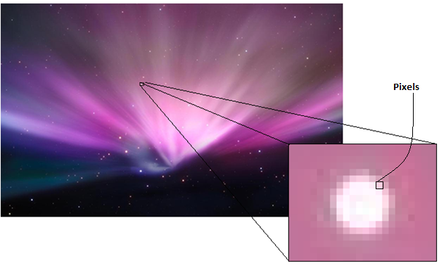
Image Encryption
Image is composed of very tiny Pixels. Each Pixel has a RGB Code. Now one way to see a picture is in the form of a Pixel matrix or a 2d pixel array.

Slide 14
A RGB pixel consists of three components that are Red, Green and Blue.
What I did is that I will convert the value of text into pixel’s green component :
A | B | C | D | E | F | G | H | I | J | K | L | M | N | O | P | Q | R | S | T | U | V | W | X | Y | Z
1 | 2 | 3 | 4 | 5 | 6 | 7 | 8 | 9 | 10 | 11 | 12 | 13 | 14 | 15 | 16 | 17 | 18 | 19 | 20 | 21 | 22 | 23 | 24 | 25 | 26
‘ ‘ | 0 | 1 | 2 | 3 | 4 | 5 | 6 | 7 | 8 | 9
27 | 28 | 29 | 30 | 31 | 32 | 33 | 34 | 35 | 36 | 37
With image stagenography, attacker won’t be
aware of if any secret message even exists or not !!
That’s the best part.

Slide 15
GUI
User interface with options :
Enter your original message (may ask for input image to hide the message).
Encrypt (will print the encrypted message and display the key ).
Decrypt using the key and image (original message will be displayed).
Also, a link to a help section contains detailed information about the software and the encryption techniques involved in the project.

Slide 16
APPLICATIONS
Electronic cash (electronic credit card and debit card).
Electronic signatures (Digital signatures).
Authentication.
Secure network communications.
Disk Encryption.
Secrecy in transmission.
Secrecy in storage.

Slide 17
REFERENCES
Introduction to Cryptography With Coding Theory-by Wade Trappe and Lawrence C Washington (Pearson Education).
Applied cryptography by Bruce Schneier : http://meta.stackoverflow.com/questions/136389/tags-for-cryptographic-algorithms-and-standards
ACM : http://cs.stanford.edu/people/eroberts/jtf/javadoc/student/index.html

Slide 18
THE END

